Slide 1


Acme
Corporation
Digital Identity and Access Management
Details Matter
June 10, 2022

Slide 2
Agenda
1.
About Accenture
2.
Accenture Overview
3.
Our Team
4.
Industry Experience
5.
Our Expertise
6.
Our Core Values

Slide 3
Accenture is a leading professional services company, with capabilities in strategy, consulting, digital, technology and operations.
We help organizations maximize their performance and achieve their vision
We develop and implement technology solutions to improve our clients’ productivity and efficiency –and may run parts of their business
Ultimately, we enable our clients to become high-performance businesses and governments

Slide 4
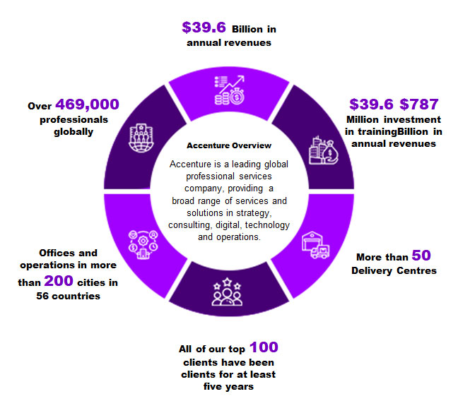
Accenture Overview

Slide 5

Our people are passionate about serving clients.

Slide 6
Industry Experience
Strategy & Consulting
Interactive
Technology
Operations
Communications, Media & Technology
Communications & Media
High Tech
Software & Platforms
Financial Services
Banking & Capital Markets
Insurance
Health & Public Service
Health
Public Service
Products
Consumer Goods, Retail & Travel Services
Industrial
Life Sciences
Chemicals & Natural Resources
Energy
Utilites
Resources

Slide 7

Our
Expertise
Extensive industry expertise.
Broad and evolving service offerings.
Expertise in business transformation outsourcing.
History of technology innovation and implementation, including spend approximately $300 million annually.
Commitment to the long-term development of our employees.
Proven and experienced management team

Slide 8
Accenture’s Core values
Stewardship
Building a heritage for future generations, acting with an owner mentality, our commitments to all internal and external stakeholders.
Best People
Attracting and developing the best talent for our business, stretching our people and developing a "can do" attitude.
Client Value Creation
Improving our clients' business performance, creating long-term, win-win relationships and focusing on execution excellence.
One Global Network
Mobilizing the power of teaming to deliver consistently exceptional service to our clients anywhere in the world.
Respect for the Individual
Valuing diversity, ensuring an interesting and inclusive environment, and treating people as we would like to be treated ourselves.
Integrity
Inspiring trust by taking responsibility, acting ethically, and encouraging honest and open debate.

Slide 9
Thank You

